Slide 1
Software Design Review
William Brown

Slide 2
What does the software do?
In this project, I have chosen to make a web-based currency conversion application that is using an web-based api to convert international currencies, as well as; keep the conversions up to date with current international market value.
This program is also intended to serve as a form of educational material by providing the countries flag a a breif explanation of the history for each currency.

Slide 3
How you designed your software to meet the desired outcome?
My goal for this projects design was to make it as simplistic and easy to use as possible while still maintaining the accuracy and integrity of the initial idea of the project.
The way I have obtained this is I keep the layout and design of all the elements in the project easily visible and simple to understand for even the most basic users.
I also made the color scheme of the entire project darker and less vibrant so it would help with eye strain and be easier on the eyes of the user.

Slide 4
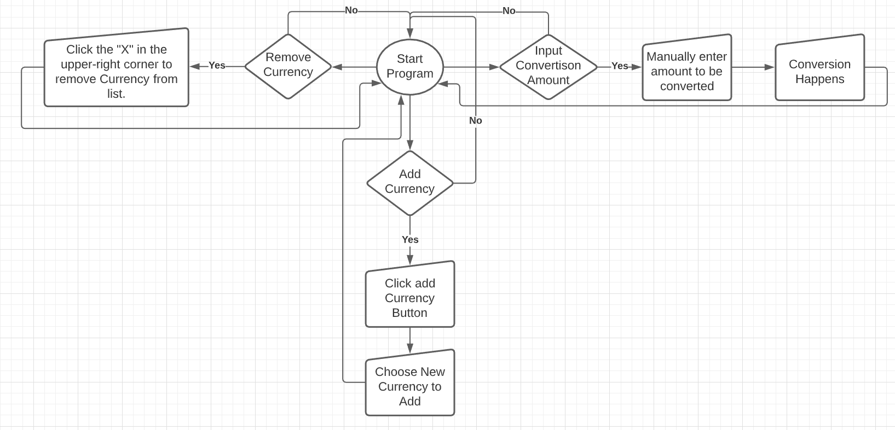
State Diagram of the Software?

